Slide 1
VARIABLES

Slide 2
Variable
what is a variable?
A space in the computer's memory where a value is stored that may change during program execution.
why do you have to use variables?
because when creating a program the need arises to store data temporarily that you will need to use in the future in the same program.
what is initializing a variable?
is to give it a value.
Variable_name = value
salary = 2000
Java does not allow to use variables that have not been initialized.

Slide 3
Syntax
type
variableName
=
value
;
Example:
Create a variable called name of type String and assign it the value "John“
String name = “John”;
Example:
Create a variable called myNum of type int and assign it the value 15: int myNum = 15;

Slide 4
Final Variables
If you don't want others (or yourself) to overwrite existing values, use the final keyword (this will declare the variable as "final" or "constant", which means unchangeable and read-only):
Example:
Final int myNum = 15;
myNum = 20; //will generate an error: cannot assign a value to a final variable

Slide 5
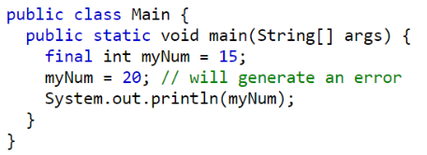
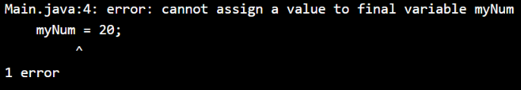
Final Variables
The following code is generated where a final variable is declared and then an attempt is made to overwrite it
In the console it is observed that an error is generated.

Slide 6

Declare Many Variables
To declare more than one variable of the same type, you can use a comma-separated list:

Slide 7
Identifiers
All variables must be identified with unique names.
These unique names are called identifiers.
Identifiers can be short names (like x and y) or more descriptive names (age, sum, totalVolume).

Slide 8
Identifiers
The general rules for naming variables are:
Names can contain letters, digits, underscores, and dollar signs
Names must begin with a letter
Names should start with a lowercase letter and it cannot contain whitespace
Names can also begin with $ and _
Names are case sensitive ("myVar" and "myvar" are different variables)
Reserved words (like Java keywords, such as int or boolean) cannot be used as names

